Slide 1
Java Plays – Mobile Starter Kit - Starter (Extend)
IBM

Slide 2


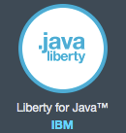

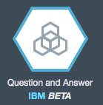
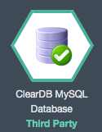
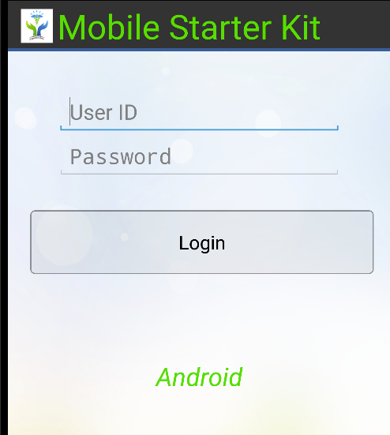
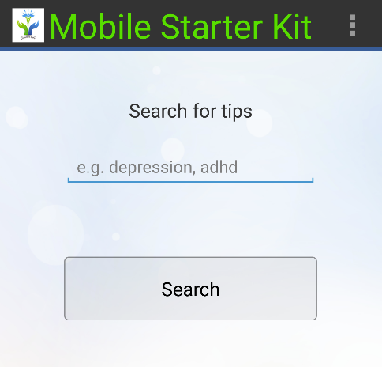
Mobile Starter Kit
Mobile Application (Android)
B
Starter
Basic Mobile Application (Android)
Basic Bluemix Java Application – REST Services
Bluemix Java Application
REST
USE CASE – A Cognitive health care solution that provides information about a disease or a symptom
Extend Bluemix Java Application
B
Extend Bluemix Java App
Extend the Basic RESTful Service to perform real time operations
Publish REST Service (Liberty & Java)
Bluemix Services
Extend Mobile Application (Android)
B
Extend Mobile Application
Extend the Mobile App to Integrate with the REST Services (Login, Searchtips)
Mobile Application
Bluemix Java App (Runtimes and Services)
REST
Notes:
2

Slide 3
Agenda
Extend Bluemix Java Application
Use Case and Application Architecture
Create Bluemix Services
Connect to Bluemix Services
Read From VCAP
Connect to Services
Create REST Service Calls for Use Case
login
register
searchtips
Extend Mobile UI (Application)
Mobile Application Design
Mobile Application UI Flow
Task Execution Protocol
Integrating Components

Slide 4

Extend Bluemix Java Application – Use Case
Login User
Use Case:
Register
User
Update User
Search Concept
Ask a Question

Slide 5
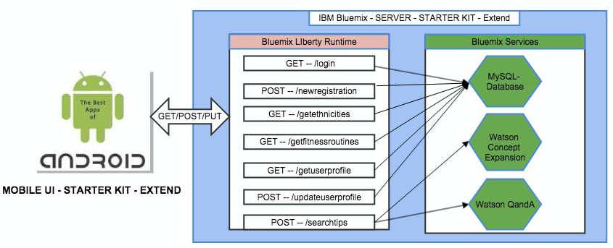
Extend Bluemix Java Application – Application Architecture
There are two parts for this application
Client Side is a Android Mobile Application that is used to retrieve and display information of the disease or symptom searched by a user.
Server Side is a Bluemix Java application that publishes required information via RESTful API’s invoking backend Bluemix Cognitive Services. These RESTful API calls provide Android Mobile Application with the information about the disease or symptom requested by the user.

Slide 6
Extend Bluemix Java Application – Pull the code
Pull the code rest services api java code from the jazzhub git repository.
https://hub.jazz.net/git/ecosysdevcnc/javaplays-mobilestarterkit/
javaplays-restjavafull-mobilestarterkit

Slide 7
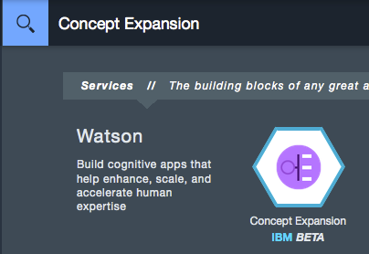
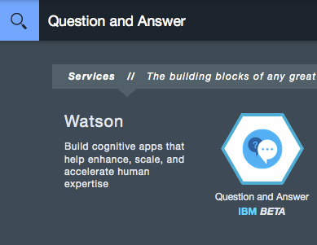
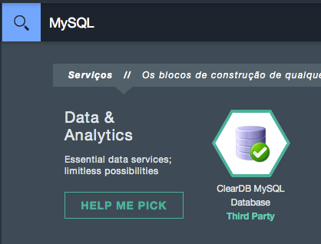
Extend Bluemix Java Application – Create Bluemix Services
Create 3 Bluemix Services
Login to Bluemix → Catalog → Search for Service → Create
Watson Concept Expansion Service
Watson Q and A Service
Clear MySQL DB Service

Slide 8
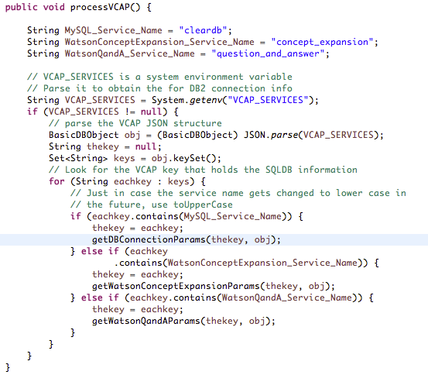
Bluemix Java Application – Read VCAP Environment Variables
ServiceDiscovery.java – Read VCAP environment variables
Service Discovery class → com.ibm.bluemix.startkit.services
The process VCAP method in the service class reads all the VCAP environment various defined for that application.
There are three services configured in Bluemix for this application
ClearDB MySQL
Concept Expansion
Question and Answer

Slide 9
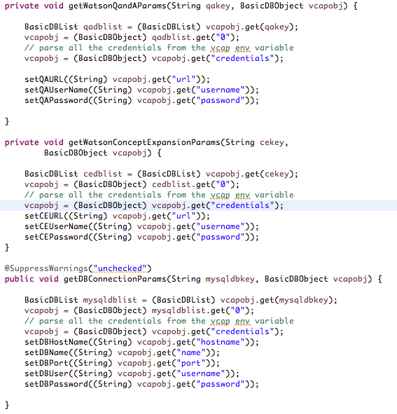
Bluemix Java Application – Connect to Services
Service Discovery.java – Read Bluemix Services environment variables
getWatsonQandAParams → This method retrieves all the VCAP environment variables available for Watson Q and A Service in Bluemix
getWatsonConceptExpansionParams → This method retrieves all the VCAP environment variables available for Watson Concept Expansion Service in Bluemix
getDBConnectionParams → This method retrieves all the VCAP environment variables available for Clear MySQL DB Service in Bluemix

Slide 10
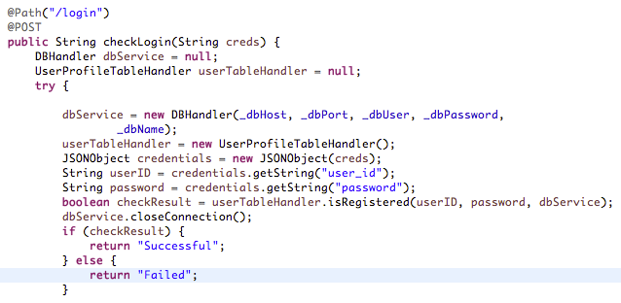
Bluemix Java Application – Login REST Service
login REST Service
ServiceAPI.java → This class defines all the REST Services for this application
/login REST Call →
Application receives the credentials from the Mobile UI in a JSON format.
Parses the credentials
Connects to the Clear SQL MyDB Service
Perform a select query on the login table to validate the credentials
Returns a success or failure based on the response

Slide 11
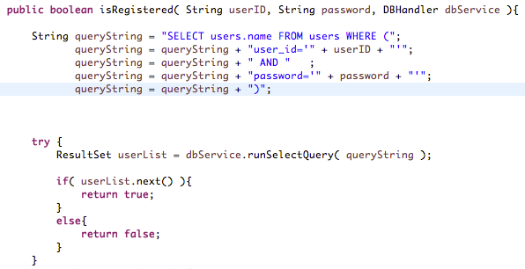
Bluemix Java Application – Login REST Service (Cont’d)
login REST Service
/login REST Call →
Application receives the credentials from the Mobile UI in a JSON format.
Parses the credentials
Connects to the Clear SQL MyDB Service
Perform a select query on the login table to validate the credentials
Returns a success or failure based on the response

Slide 12
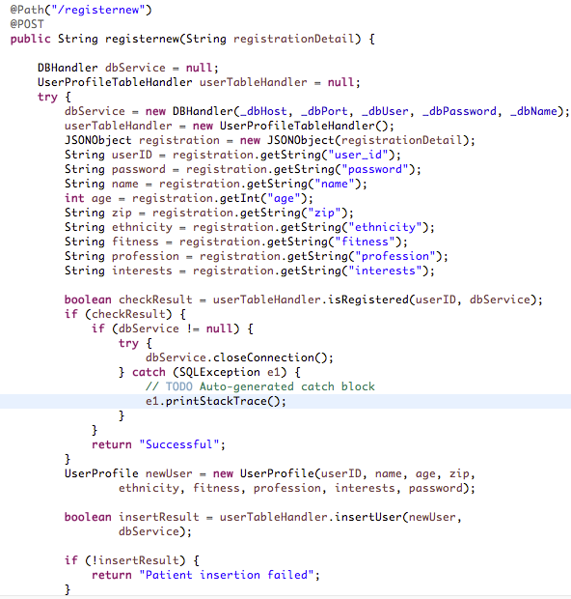
Bluemix Java Application – Register New User REST Service
Register new user REST Service
/registernew REST Call →
Application receives the user infromation from the mobile UI in a JSON format.
Performs a insert user in to user table in the database
Returns a success or failure based on database insert response

Slide 13
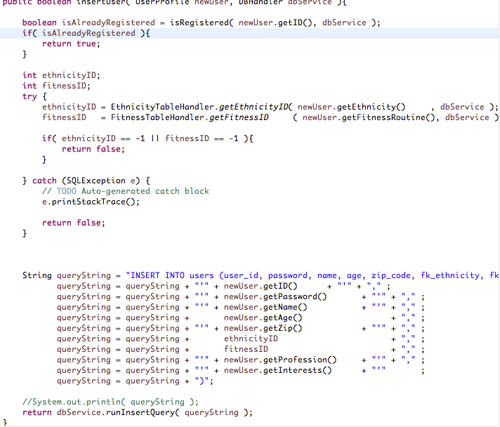
Bluemix Java Application – Register New User REST Service
Register new user REST Service
/registernew REST Call
Application receives the user information from the Mobile UI in a JSON format.
Performs a insert user in to user table in the database
Returns a success or failure based on database insert response

Slide 14
Bluemix Java Application – Register New User REST Service
searchtips REST Service
/searchtips REST Call →
This rest call communicates with Watson Concept Expansion and Watson Q and A service for the input passed in to the mobile application search screen
This call parses and converts the output from the watson services to JSON format
The JSON format output will passed as an output to the /searchtips rest call.
The results are displayed on the Mobile UI Search screen.

Slide 15
Extend Mobile Application – Using Full Power of Bluemix

Slide 16
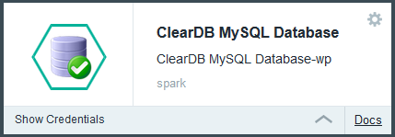
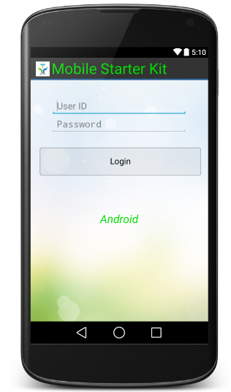
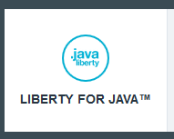
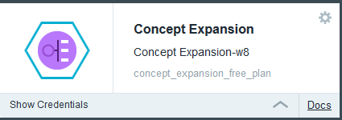
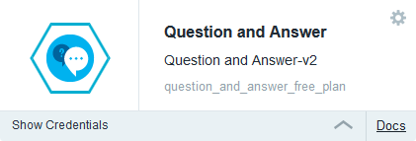
Light UI – Heavy Server side
Notes:
16

Slide 17
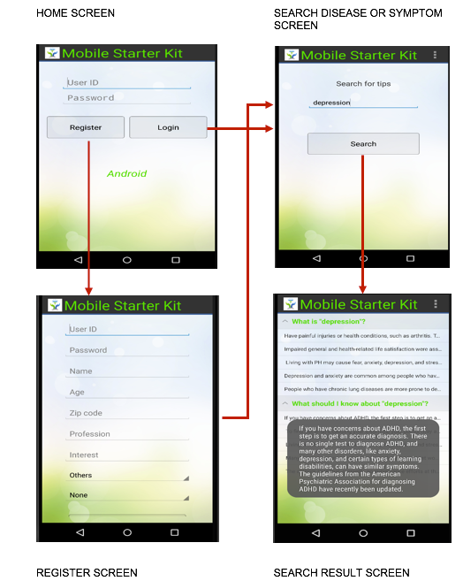
Mobile UI Flow

Slide 18
Task Execution Protocol – Step by step
S1 :
Activity creates the task and assigns an ID to it
Activity registers itself as a listener to the postExecution event of the task
Activity starts the task in a separate thread
S2 :
Task executes a POST method and waits for the result
S3 :
The response is received by the task thread
Task raises a postExecute() event and passes the response to any listener
S4 :
Activity responds to the event and process the result
S1
S2
Task
Extends : AsyncServiceTask
S4
S3
Activity
Implements : TaskReceiver
Notes:
18

Slide 19
Task Execution Protocol – Step by step
//SearchUI.java – if the user clicks the button
{
...
SearchTipsTask stt = new SearchTipsTask( ... );
stt.setReceiver(this);
stt.execute(_seeds);
...
}
S1
//AsyncServiceTask.java
@Override
protected String doInBackground( String... params ) {
//performTask is implemented by the
//SearchTipsTask class
return performTask( params );
}
S2
S3
@Override
public void receiveResult( String response,
String source ) {
{
//make sure the task ID is the search task
if( source.equals( correct_id ) ){
//perhaps do something with the response
}
}
S4
//AsyncServiceTask.java
@Override
protected void onPostExecute( String result ){
_response = result;
if( _tr != null ){
//calls the receiver's receiveResult function
//adds the serviceID here
//in this case the receiver is SearchUI.java
_tr.receiveResult( _response,_serviceID);
}
}
}
Notes:
19

Slide 20
How are all these stitched together? - without headache
com.ibm.android.asynctask.TaskReceiver - Interface
Every activity that required to use a REST API implements this class
This class enforces the activities to declare a receiveResult function
String response
The response received from REST call
String Source
The ID of the asynchronous task generating the response
public interface TaskReceiver{
public void receiveResult( String response, String source );
}
//Example : SearchUI.java
public void receiveResult( String response, String source ) {
//make sure the task ID is the search task
if( source.equals( SearchTipsTask._SEARCH_DOC_ID ) ){
//do something with the response
}
}
Notes:
20

Slide 21
How are all these stitched together? - without headache
com.ibm.android.asynctask.AsyncServiceTask - Abstract
Every task that calls REST API extends this class
This class enforces the tasks to define a REST API call
String... params
Input parameter needed for the task
public abstract String performTask( String... params)
throws IOException, JSONException, URISyntaxException;
//Example : SearchTipsTask
@Override
protected String performTask(String... params) throws IOException,
JSONException, URISyntaxException {
//retrieve the parameter
String keyword = params[0];
//POST and return the response
return performPost( ... );
}
Notes:
21

Slide 22
Questions?

